Slide 1

Data Communication and Networking (DCAN 202)
Week 11
Kent Institute Australia Pty. Ltd.
ABN 49 003 577 302 CRICOS Code: 00161E RTO Code: 90458 TEQSA Provider Number: PRV12051
Version 2 – 18th December 2015

Slide 2
Chapter Six
Errors, Error Detection, and Error Control
Data Communications and Computer Networks: A Business User’s Approach
Eighth Edition
© 2016. Cengage Learning. All Rights Reserved.

Slide 3
After reading this chapter, you should be able to:
Identify the different types of noise commonly found in computer networks
Specify the different error-prevention techniques, and be able to apply an error-prevention technique to a type of noise
Compare the different error-detection techniques in terms of efficiency and efficacy
Perform simple parity and longitudinal parity calculations, and enumerate their strengths and weaknesses
Data Communications and Computer Networks: A Business User's Approach, Eighth Edition
© 2016. Cengage Learning. All Rights Reserved.

Slide 4
After reading this chapter, you should be able to (continued):
Cite the advantages of arithmetic checksum
Cite the advantages of cyclic redundancy checksum, and specify what types of errors cyclic redundancy checksum will detect
Differentiate between the basic forms of error control, and describe the circumstances under which each may be used
Follow an example of a Hamming self-correcting code
Data Communications and Computer Networks: A Business User's Approach, Eighth Edition
© 2016. Cengage Learning. All Rights Reserved.

Slide 5
Introduction
Noise is always present
If a communications line experiences too much noise, the signal will be lost or corrupted
Communication systems should check for transmission errors
Once an error is detected, a system may perform some action
Some systems perform no error control, but simply let the data in error be discarded
Data Communications and Computer Networks: A Business User's Approach, Eighth Edition
© 2016. Cengage Learning. All Rights Reserved.

Slide 6
White Noise
Also known as thermal or Gaussian noise
Relatively continuous type of noise and is much like the static you hear when a radio is being tuned between two stations.
Dependent on the temperature of the medium. As the temperature increases, the level of noise increases due to the increased activity of the electrons in the medium.
If white noise gets too strong, it can completely disrupt the signal
Data Communications and Computer Networks: A Business User's Approach, Eighth Edition
© 2016. Cengage Learning. All Rights Reserved.

Slide 7
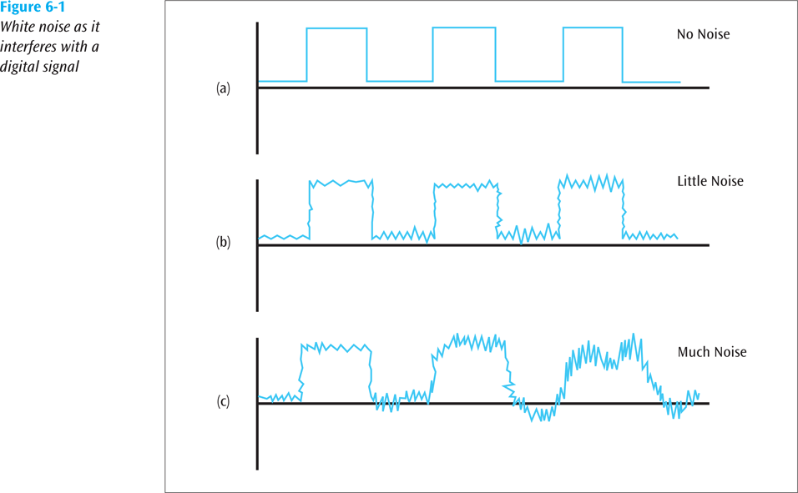
White Noise (continued)
Data Communications and Computer Networks: A Business User's Approach, Eighth Edition
© 2016. Cengage Learning. All Rights Reserved.

Slide 8
Impulse Noise
A noncontinuous noise and one of the most disruptive forms of noise
Typically, the noise is an analog burst of energy.
Difficult to remove from an analog signal because it may be hard to distinguish from the original signal
Impulse noise can damage more bits if the bits are closer together (transmitted at a faster rate)
Data Communications and Computer Networks: A Business User's Approach, Eighth Edition
© 2016. Cengage Learning. All Rights Reserved.

Slide 9
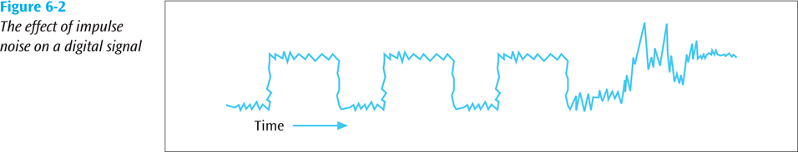
Impulse Noise (continued)
Data Communications and Computer Networks: A Business User's Approach, Eighth Edition
© 2016. Cengage Learning. All Rights Reserved.

Slide 10
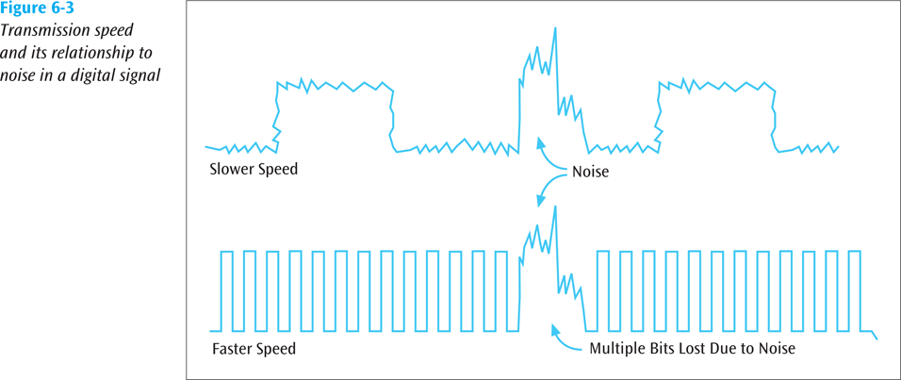
Impulse Noise (continued)
Data Communications and Computer Networks: A Business User's Approach, Eighth Edition
© 2016. Cengage Learning. All Rights Reserved.
Notes:
The bottom figure should show much more distortion, completely blowing out one or two bits of information.

Slide 11
Crosstalk
Unwanted coupling between two different signal paths
For example, hearing another conversation while talking on the telephone
Relatively constant and can be reduced with proper measures
Data Communications and Computer Networks: A Business User's Approach, Eighth Edition
© 2016. Cengage Learning. All Rights Reserved.

Slide 12
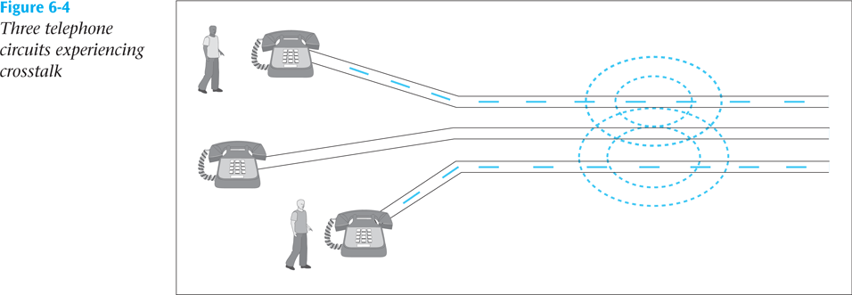
Crosstalk (continued)
Data Communications and Computer Networks: A Business User's Approach, Eighth Edition
© 2016. Cengage Learning. All Rights Reserved.

Slide 13
Echo
The reflective feedback of a transmitted signal as the signal moves through a medium (Much like the way a voice will echo in an empty room).
A signal can hit the end of a cable, bounce back through the wire, and interfere with the original signal.
Most often occurs on coaxial cable
If echo bad enough, it could interfere with original signal
Relatively constant, and can be significantly reduced
Data Communications and Computer Networks: A Business User's Approach, Eighth Edition
© 2016. Cengage Learning. All Rights Reserved.

Slide 14
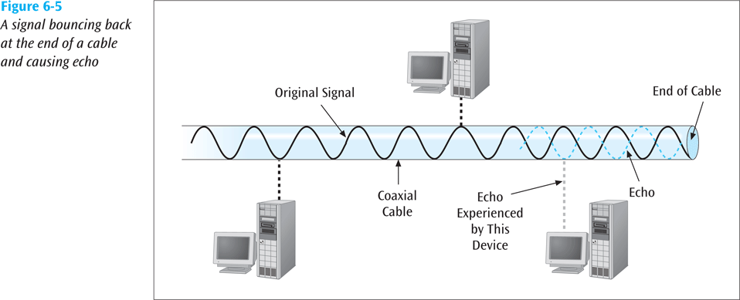
Echo (continued)
Data Communications and Computer Networks: A Business User's Approach, Eighth Edition
© 2016. Cengage Learning. All Rights Reserved.

Slide 15
Jitter
The result of small timing irregularities during the transmission of digital signals
Occurs when a digital signal is repeated over and over
If serious enough, jitter forces systems to slow down their transmission
If unchecked, jitter can cause video devices to flicker, audio transmissions to click and break up, and transmitted computer data to arrive with errors.
Data Communications and Computer Networks: A Business User's Approach, Eighth Edition
© 2016. Cengage Learning. All Rights Reserved.

Slide 16
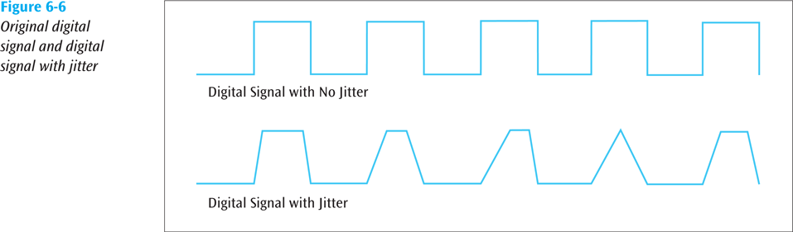
Jitter (continued)
Data Communications and Computer Networks: A Business User's Approach, Eighth Edition
© 2016. Cengage Learning. All Rights Reserved.

Slide 17
Attenuation
The continuous loss of a signal’s strength as it travels through a medium
Attenuation can be eliminated with the use of amplifiers for analog systems or repeaters for digital systems.
Data Communications and Computer Networks: A Business User's Approach, Eighth Edition
© 2016. Cengage Learning. All Rights Reserved.

Slide 18
Error Prevention
To prevent errors from happening, several techniques may be applied:
Proper shielding of cables to reduce interference
Be ware many different types of wireless applications share the same wireless frequencies. Even some non-wireless devices generate signals that can interfere with wireless applications. For example, microwave ovens can interfere with some wireless LAN signal
Replacing older media and equipment with new, possibly digital components
Proper use of digital repeaters and analog amplifiers
Observe the stated capacities of the media
Data Communications and Computer Networks: A Business User's Approach, Eighth Edition
© 2016. Cengage Learning. All Rights Reserved.

Slide 19
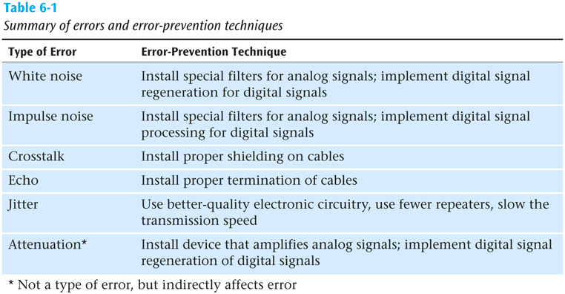
Error Prevention (continued)
Data Communications and Computer Networks: A Business User's Approach, Eighth Edition
© 2016. Cengage Learning. All Rights Reserved.

Slide 20
Error Detection
Despite the best prevention techniques, errors may still happen
To detect an error, something extra has to be added to the data/signal
This extra is an error detection code
Three basic techniques for detecting errors: parity checking, arithmetic checksum, and cyclic redundancy checksum
Data Communications and Computer Networks: A Business User's Approach, Eighth Edition
© 2016. Cengage Learning. All Rights Reserved.

Slide 21
Parity Checks
Simple parity
easiest error-detection method to incorporate into a transmission system.
Two basic forms: Even parity and Odd parity.
The basic concept of parity checking is that a bit is added to a string of bits to create either even parity or odd parity.
With even parity, the 0 or 1 added to the string produces an even number of binary 1s. With odd parity, the 0 or 1 added to the string produces an odd number of binary 1s.
Data Communications and Computer Networks: A Business User's Approach, Eighth Edition
© 2016. Cengage Learning. All Rights Reserved.

Slide 22
Parity Checks (continued)
If the 7-bit ASCII character set is used, a parity bit is added as the eighth bit.
Suppose, for example, that the character “k”—which is 1101011 in binary—is transmitted and even parity is being applied. In this case, a parity bit of 1 would be added to the end of the bit stream, as follows: 11010111. There is now an even number (six) of 1s. (If odd parity were used, a 0 would be added at the end, resulting in 11010110.)
Data Communications and Computer Networks: A Business User's Approach, Eighth Edition
© 2016. Cengage Learning. All Rights Reserved.

Slide 23
Parity Checks (continued)
What happens if 11010111 with even parity is sent and two bits are corrupted?
For example, 00010111 is received. Will an error be detected?
The answer is no, an error will not be detected because the number of 1s is still even.
Data Communications and Computer Networks: A Business User's Approach, Eighth Edition
© 2016. Cengage Learning. All Rights Reserved.

Slide 24
Parity Checks (continued)
Longitudinal parity
Tries to solve the main weakness of simple parity— that all even numbers of errors are not detected.
The first step of this parity scheme involves grouping individual characters together in a block, as shown in Table 6-2. Each character (also called a row) in the block has its own parity bit.
Data Communications and Computer Networks: A Business User's Approach, Eighth Edition
© 2016. Cengage Learning. All Rights Reserved.

Slide 25
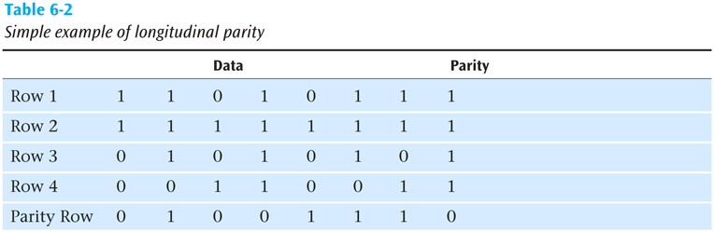
Parity Checks (continued)
Data Communications and Computer Networks: A Business User's Approach, Eighth Edition
© 2016. Cengage Learning. All Rights Reserved.

Slide 26
Parity Checks (continued)
Longitudinal parity
In addition, after a certain number of characters are sent, a row of parity bits, or a block character check, is also sent.
Each parity bit in this last row is a parity check for all the bits in the column above it.
If one bit is altered in Row 1, the parity bit at the end of Row 1 signals an error. In addition, the parity bit for the corresponding column also signals an error.
If two bits in Row 1 are flipped, the Row 1 parity check will not signal an error, but two column parity checks will signal errors.
Data Communications and Computer Networks: A Business User's Approach, Eighth Edition
© 2016. Cengage Learning. All Rights Reserved.

Slide 27
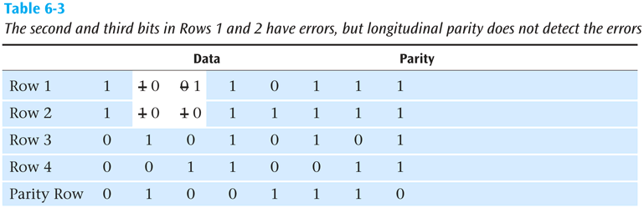
Parity Checks (continued)
Data Communications and Computer Networks: A Business User's Approach, Eighth Edition
© 2016. Cengage Learning. All Rights Reserved.

Slide 28
Parity Checks (continued)
Both simple parity and longitudinal parity do not catch all errors
Simple parity only catches odd numbers of bit errors
Longitudinal parity is better at catching errors but requires too many check bits added to a block of data
We need a better error detection method
What about arithmetic checksum?
Data Communications and Computer Networks: A Business User's Approach, Eighth Edition
© 2016. Cengage Learning. All Rights Reserved.

Slide 29
Arithmetic Checksum
Used in TCP and IP on the Internet
Characters to be transmitted are converted to numeric form and summed
Sum is placed in some form at the end of the transmission
Data Communications and Computer Networks: A Business User's Approach, Eighth Edition
© 2016. Cengage Learning. All Rights Reserved.

Slide 30
Arithmetic Checksum
Simplified example:
56
72
34
48
210
Then bring 2 down and add to right-most position
10
2
12
Data Communications and Computer Networks: A Business User's Approach, Eighth Edition
© 2016. Cengage Learning. All Rights Reserved.

Slide 31
Arithmetic Checksum
Receiver performs same conversion and summing and compares new sum with sent sum
TCP and IP processes a little more complex but idea is the same
But even arithmetic checksum can let errors slip through. Is there something more powerful yet?
Data Communications and Computer Networks: A Business User's Approach, Eighth Edition
© 2016. Cengage Learning. All Rights Reserved.

Slide 32
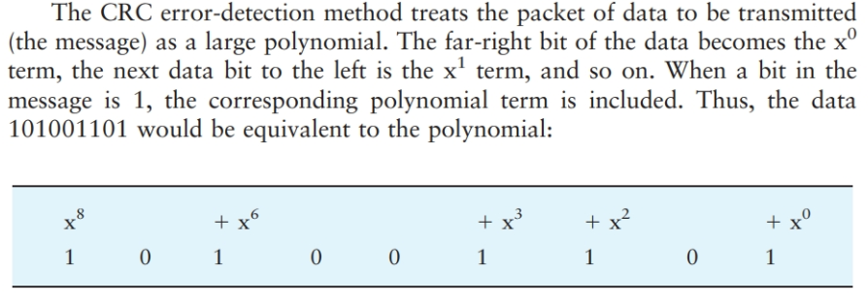
Cyclic Redundancy Checksum
Typically adds 8 to 32 check bits to potentially large data packets and yields an error-detection capability approaching 100 percent.
Data Communications and Computer Networks: A Business User's Approach, Eighth Edition
© 2016. Cengage Learning. All Rights Reserved.

Slide 33
Cyclic Redundancy Checksum (continued)
Using polynomial arithmetic, divides it by a given generating polynomial, and produces a quotient and a remainder.
The message (with the remainder) is transmitted to the receiver
Data Communications and Computer Networks: A Business User's Approach, Eighth Edition
© 2016. Cengage Learning. All Rights Reserved.

Slide 34
Cyclic Redundancy Checksum (continued)
The receiver divides the message and remainder by the same generating polynomial
If a remainder not equal to zero results, there was an error during transmission
If a remainder of zero results, there was no error during transmission
Data Communications and Computer Networks: A Business User's Approach, Eighth Edition
© 2016. Cengage Learning. All Rights Reserved.

Slide 35
Cyclic Redundancy Checksum (continued)
Some standard generating polynomials:
CRC-12: x¹² + x¹¹ + x³ + x² + x + 1
CRC-16: x¹⁶ + x¹⁵ + x² + 1
CRC-CCITT: x¹⁶ + x¹⁵ + x⁵ + 1
CRC-32: x³² + x²⁶ + x²³ + x²² + x¹⁶ + x¹² + x¹¹ + x¹⁰ + x⁸ + x⁷ + x⁵ + x⁴ + x² + x + 1
ATM CRC: x⁸ + x² + x + 1
Data Communications and Computer Networks: A Business User's Approach, Eighth Edition
© 2016. Cengage Learning. All Rights Reserved.

Slide 36
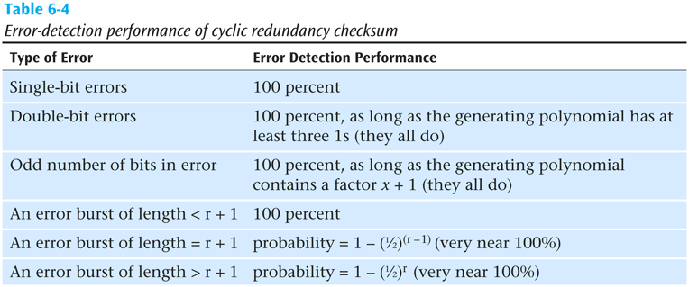
Cyclic Redundancy Checksum (continued)
Data Communications and Computer Networks: A Business User's Approach, Eighth Edition
© 2016. Cengage Learning. All Rights Reserved.

Slide 37
Error Control
Once an error is detected, what is the receiver going to do?
Simply toss the frame or packet
Return a message to the transmitter asking it to resend the data packet that was in error
Correct the error without retransmission.
Data Communications and Computer Networks: A Business User's Approach, Eighth Edition
© 2016. Cengage Learning. All Rights Reserved.

Slide 38
Do Nothing (Toss the Frame/Packet)
Seems like a strange way to control errors but some lower-layer protocols such as frame relay perform this type of error control
For example, if frame relay detects an error, it simply tosses the frame
No message is returned
Frame relay assumes a higher protocol (such as TCP/IP) will detect the tossed frame and ask for retransmission
Data Communications and Computer Networks: A Business User's Approach, Eighth Edition
© 2016. Cengage Learning. All Rights Reserved.

Slide 39
Return A Message
Once an error is detected, an error message is returned to the transmitter
Two basic forms:
Stop-and-wait error control
Sliding window error control
Data Communications and Computer Networks: A Business User's Approach, Eighth Edition
© 2016. Cengage Learning. All Rights Reserved.

Slide 40
Stop-and-Wait Error Control
Stop-and-wait is the simplest of the error control protocols
A transmitter sends a frame then stops and waits for an acknowledgment
If a positive acknowledgment (ACK) is received, the next frame is sent
If a negative acknowledgment (NAK) is received, the same frame is transmitted again
Data Communications and Computer Networks: A Business User's Approach, Eighth Edition
© 2016. Cengage Learning. All Rights Reserved.

Slide 41
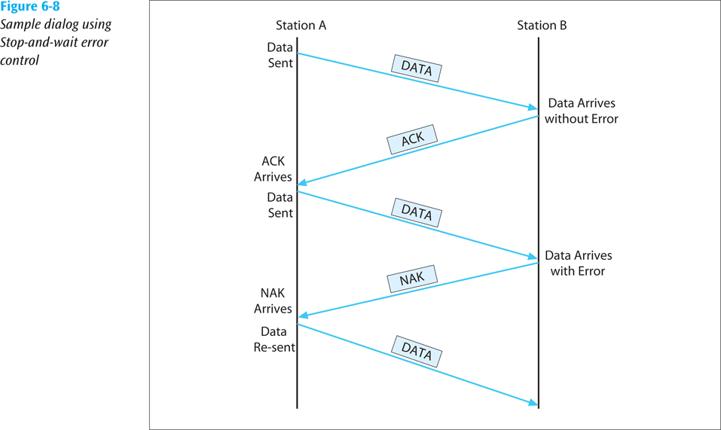
Stop-and-Wait Error Control (continued)
Data Communications and Computer Networks: A Business User's Approach, Eighth Edition
© 2016. Cengage Learning. All Rights Reserved.

Slide 42
Sliding Window Error Control
These techniques assume that multiple frames are in transmission at one time
A sliding window protocol allows the transmitter to send a number of data packets at one time before receiving any acknowledgments
Depends on window size
When a receiver does acknowledge receipt, the returned ACK contains the number of the frame expected next
Data Communications and Computer Networks: A Business User's Approach, Eighth Edition
© 2016. Cengage Learning. All Rights Reserved.

Slide 43
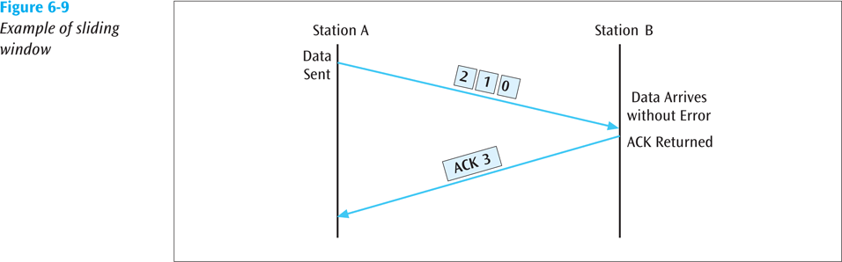
Sliding Window Error Control (continued)
Data Communications and Computer Networks: A Business User's Approach, Eighth Edition
© 2016. Cengage Learning. All Rights Reserved.

Slide 44
Sliding Window Error Control (continued)
Older sliding window protocols numbered each frame or packet that was transmitted
More modern sliding window protocols number each byte within a frame
An example in which the packets are numbered, followed by an example in which the bytes are numbered:
Data Communications and Computer Networks: A Business User's Approach, Eighth Edition
© 2016. Cengage Learning. All Rights Reserved.

Slide 45
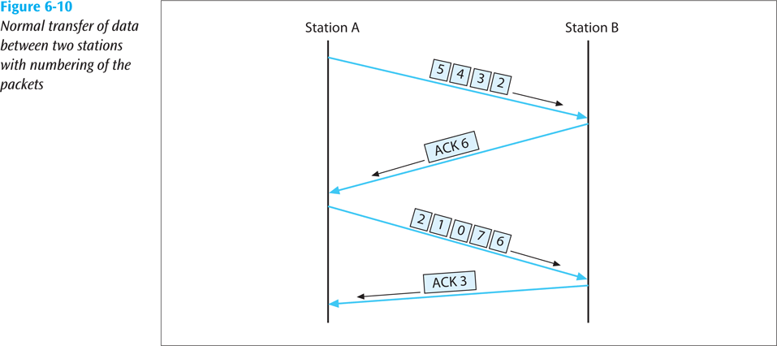
Sliding Window Error Control (continued)
Data Communications and Computer Networks: A Business User's Approach, Eighth Edition
© 2016. Cengage Learning. All Rights Reserved.

Slide 46
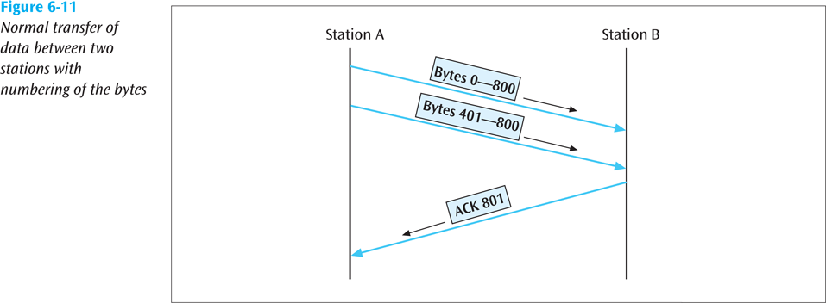
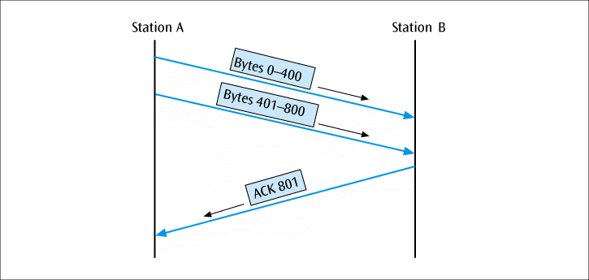
Sliding Window Error Control (continued)
Data Communications and Computer Networks: A Business User's Approach, Eighth Edition
© 2016. Cengage Learning. All Rights Reserved.

Slide 47
Sliding Window Error Control (continued)
Notice that an ACK is not always sent after each frame is received
It is more efficient to wait for a few received frames before returning an ACK
How long should you wait until you return an ACK?
Data Communications and Computer Networks: A Business User's Approach, Eighth Edition
© 2016. Cengage Learning. All Rights Reserved.

Slide 48
Sliding Window Error Control (continued)
Using TCP/IP, there are some basic rules concerning ACKs:
Rule 1: If a receiver just received data and wants to send its own data, piggyback an ACK along with that data
Rule 2: If a receiver has no data to return and has just ACKed the last packet, receiver waits 500 ms for another packet
If while waiting, another packet arrives, send the ACK immediately
Rule 3: If a receiver has no data to return and has just ACKed the last packet, receiver waits 500 ms
No packet, send ACK
Data Communications and Computer Networks: A Business User's Approach, Eighth Edition
© 2016. Cengage Learning. All Rights Reserved.

Slide 49
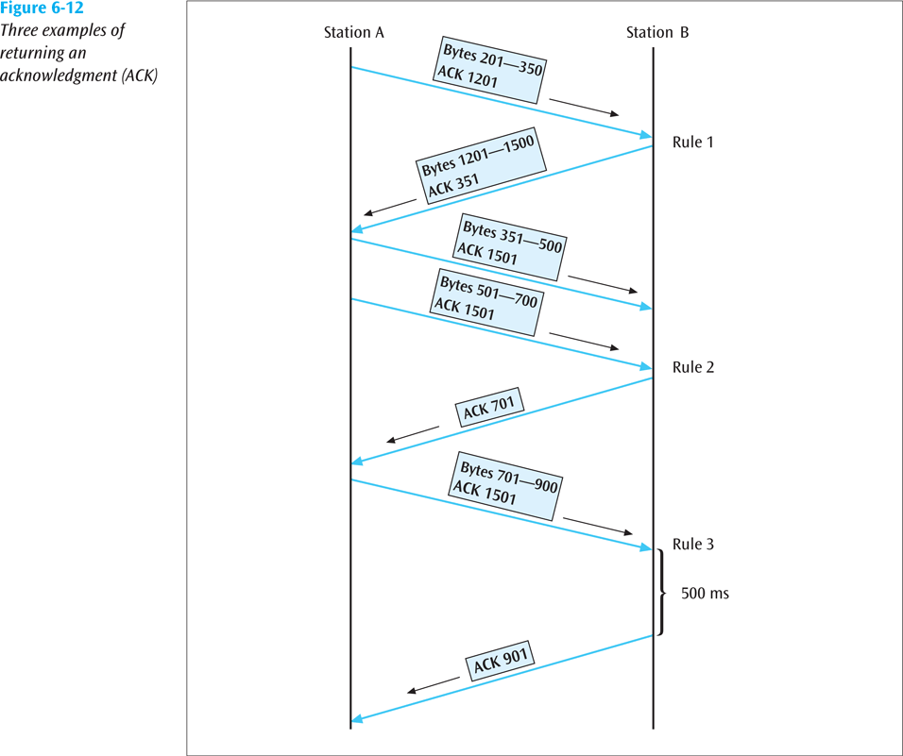
Sliding Window Error Control (continued)
Data Communications and Computer Networks: A Business User's Approach, Eighth Edition
© 2016. Cengage Learning. All Rights Reserved.

Slide 50
Sliding Window Error Control (continued)
What happens when a packet is lost?
As shown in the next slide, if a frame is lost, the following frame will be “out of sequence”
The receiver will hold the out of sequence bytes in a buffer and request the sender to retransmit the missing frame
Data Communications and Computer Networks: A Business User's Approach, Eighth Edition
© 2016. Cengage Learning. All Rights Reserved.

Slide 51
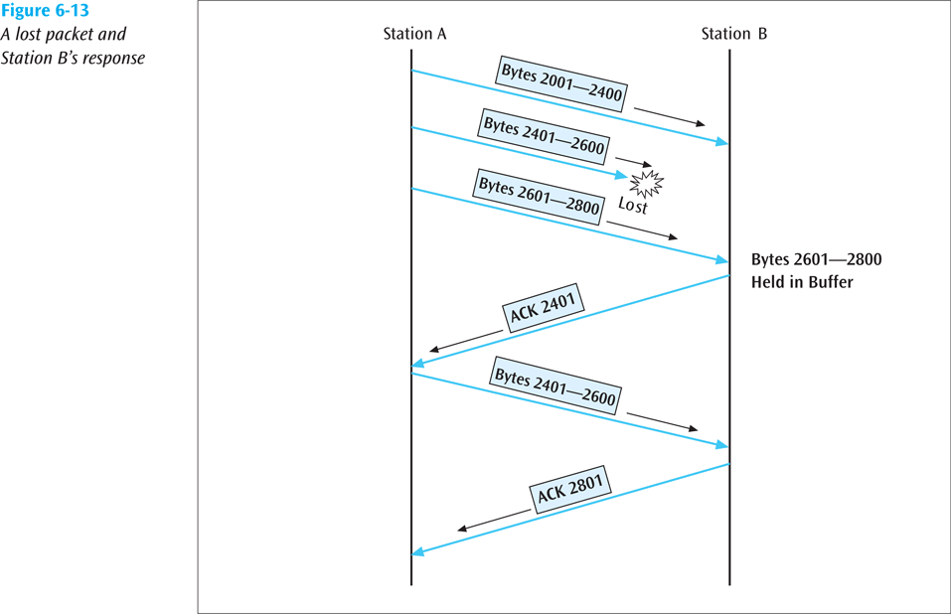
Sliding Window Error Control (continued)
Data Communications and Computer Networks: A Business User's Approach, Eighth Edition
© 2016. Cengage Learning. All Rights Reserved.

Slide 52
Sliding Window Error Control (continued)
What happens when an ACK is lost?
As shown in the next slide, if an ACK is lost, the sender will wait for the ACK to arrive and eventually time out
When the time-out occurs, the sender will resend the last frame
Data Communications and Computer Networks: A Business User's Approach, Eighth Edition
© 2016. Cengage Learning. All Rights Reserved.

Slide 53
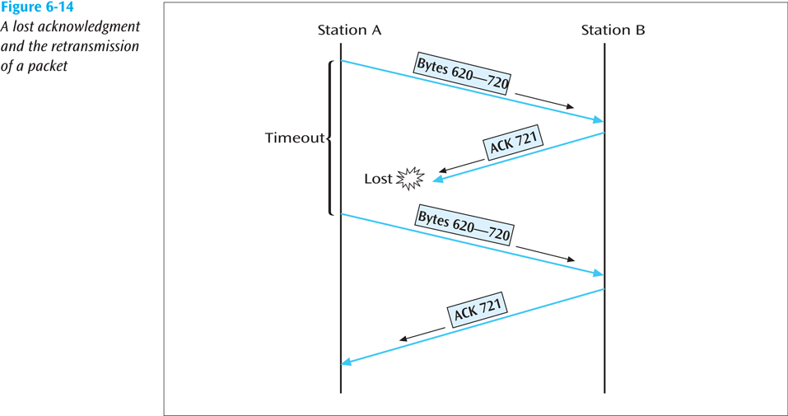
Sliding Window Error Control (continued)
Data Communications and Computer Networks: A Business User's Approach, Eighth Edition
© 2016. Cengage Learning. All Rights Reserved.

Slide 54
Correct the Error
For a receiver to correct the error with no further help from the transmitter requires a large amount of redundant information to accompany the original data
This redundant information allows the receiver to determine the error and make corrections
This type of error control is often called forward error correction and involves codes called Hamming codes
Data Communications and Computer Networks: A Business User's Approach, Eighth Edition
© 2016. Cengage Learning. All Rights Reserved.

Slide 55
Correct the Error (continued)
Hamming codes add additional check bits to a character
These check bits perform parity checks on various bits
Example: One could create a Hamming code in which 4 check bits are added to an 8-bit character
We can number the check bits c8, c4, c2 and c1
We will number the data bits b12, b11, b10, b9, b7, b6, b5, and b3
Place the bits in the following order: b12, b11, b10, b9, c8, b7, b6, b5, c4, b3, c2, c1
Data Communications and Computer Networks: A Business User's Approach, Eighth Edition
© 2016. Cengage Learning. All Rights Reserved.

Slide 56
Correct the Error (continued)
Example (continued):
c8 will perform a parity check on bits b12, b11, b10, and b9
c4 will perform a parity check on bits b12, b7, b6 and b5
c2 will perform a parity check on bits b11, b10, b7, b6 and b3
c1 will perform a parity check on bits b11, b9, b7, b5, and b3
The next slide shows the check bits and their values
Data Communications and Computer Networks: A Business User's Approach, Eighth Edition
© 2016. Cengage Learning. All Rights Reserved.

Slide 57
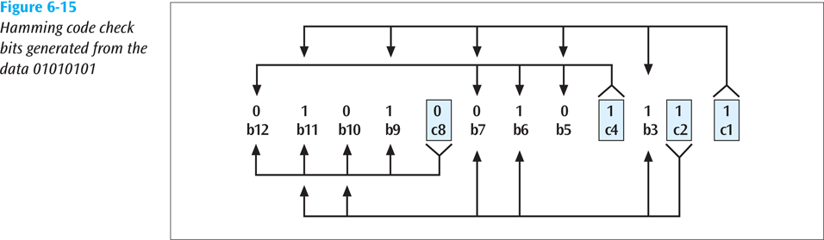
Correct the Error (continued)
Data Communications and Computer Networks: A Business User's Approach, Eighth Edition
© 2016. Cengage Learning. All Rights Reserved.

Slide 58
Correct the Error (continued)
The sender will take the 8-bit character and generate the 4 check bits as described
The 4 check bits are then added to the 8 data bits in the sequence as shown and then transmitted
The receiver will perform the 4 parity checks using the 4 check bits
If no bits flipped during transmission, then there should be no parity errors
What happens if one of the bits flipped during transmission?
Data Communications and Computer Networks: A Business User's Approach, Eighth Edition
© 2016. Cengage Learning. All Rights Reserved.

Slide 59
Correct the Error (continued)
For example, what if bit b9 flips?
The c8 check bit checks bits b12, b11, b10, b9 and c8 (01000)
This would cause a parity error
The c4 check bit checks bits b12, b7, b6, b5 and c4 (00101)
This would not cause a parity error (even number of 1s)
The c2 check bit checks bits b11, b10, b7, b6, b3 and c2 (100111)
This would not cause a parity error
Data Communications and Computer Networks: A Business User's Approach, Eighth Edition
© 2016. Cengage Learning. All Rights Reserved.

Slide 60
Correct the Error (continued)
For example, what if bit b9 flips? (continued)
The c1 check bit checks b11, b9, b7, b5, b3 and c1 (100011)
This would cause a parity error
Writing the parity errors in sequence gives us 1001, which is binary for the value 9
Thus, the bit error occurred in the 9th position
Data Communications and Computer Networks: A Business User's Approach, Eighth Edition
© 2016. Cengage Learning. All Rights Reserved.

Slide 61
Error Detection In Action
FEC is used in transmission of radio signals, such as those used in transmission of digital television (Reed-Solomon and Trellis encoding) and 4D-PAM5 (Viterbi and Trellis encoding)
Some FEC is based on Hamming Codes
Data Communications and Computer Networks: A Business User's Approach, Eighth Edition
© 2016. Cengage Learning. All Rights Reserved.

Slide 62
Summary
Noise is always present in computer networks, and if the noise level is too high, errors will be introduced during the transmission of data
Types of noise include white noise, impulse noise, crosstalk, echo, jitter, and attenuation
Among the techniques for reducing noise are proper shielding of cables, telephone line conditioning or equalization, using modern digital equipment, using digital repeaters and analog amplifiers, and observing the stated capacities of media
Data Communications and Computer Networks: A Business User's Approach, Eighth Edition
© 2016. Cengage Learning. All Rights Reserved.

Slide 63
Summary (continued)
Three basic forms of error detection are parity, arithmetic checksum, and cyclic redundancy checksum
Cyclic redundancy checksum is a superior error-detection scheme with almost 100 percent capability of recognizing corrupted data packets
Once an error has been detected, there are three possible options: do nothing, return an error message, and correct the error
Data Communications and Computer Networks: A Business User's Approach, Eighth Edition
© 2016. Cengage Learning. All Rights Reserved.

Slide 64

kent.edu.au Kent Institute Australia Pty. Ltd. ABN 49 003 577 302 ● CRICOS Code: 00161E ● RTO Code: 90458 ● TEQSA Provider Number: PRV12051
Kent Institute Australia Pty. Ltd. ABN 49 003 577 302 ● CRICOS Code: 00161E ● RTO Code: 90458 ● TEQSA Provider Number: PRV12051

